Slide 1







LabourLens
Analyzing & Predicting Qatar’s Workforce Trends
Edited by Manhill
Joy Anne Dela Cruz
Djihane Mahraz
Tehreem Masroor
Sidra Amina
Urooj Shah

Slide 2



Table of Contents
03 National Development Strategy
01 Project Overview
02 Qatar National Vision 2030 Pillars
04 Sustainable Development Goals
05 Datasets Used
06 Aggregated Data
07 Code Demonstrations
08 Advanced Predictive Modeling
09 Summary Plots
2

Slide 3



Project Overview
LaborLens is a project focused on the descriptive and predictive analysis of Qatar's labor market.
Goal
Provide valuable insights based on economic activity,
gender, education level, and GDP trends
Audience
Serve policymakers, researchers, and businesses by helping them understand labor market trends and make informed decisions
Purpose
Understand labour market trends and support
decision-making with reliable information.
3

Slide 4



Alignment With The
Qatar National Vision 2030
Human Development
Economic Development
Social Development
By providing data-driven insights on labor market trends - helps optimize economic policies and supports economic growth
By addressing gender wage disparities and workforce inclusivity contributing to social equity and justice.
Enhances workforce planning by aligning education and employment needs, contributing to a skilled labor force
4

Slide 5

Alignment With The
National Development Strategy (NDS3)
Our workforce analysis supports economic diversification by identifying high-growth sectors and predictive wage model helps businesses and policymakers make informed labor market decisions.
Sustainable Economic Growth
Future-Ready Workforce
Cohesive Society
Enables workforce planning by highlighting skill gaps and aligning education with job market needs.
Helps attract and retain high-skilled talent by forecasting industry demand and wage trends.
By addressing gender wage disparities, the project promotes social inclusion and workforce equity.
Supports integrated labor policies that foster a harmonious and diverse workforce.
5

Slide 6




SDG 5: Gender
Equality
SDG 9: Industry, Innovation, and Infrastructure
Sustainable Development Goals
SDG 5: Gender
Equality
SDG 8: Decent Work and Economic Growth
SDG 10: Reduced Inequalities
6

Slide 7

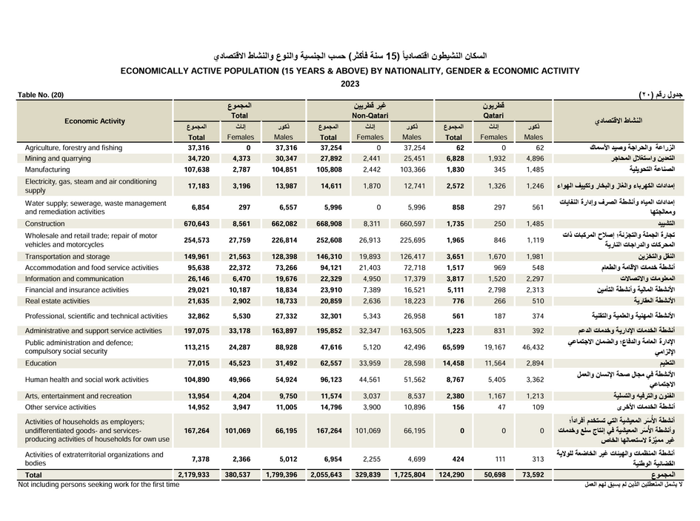
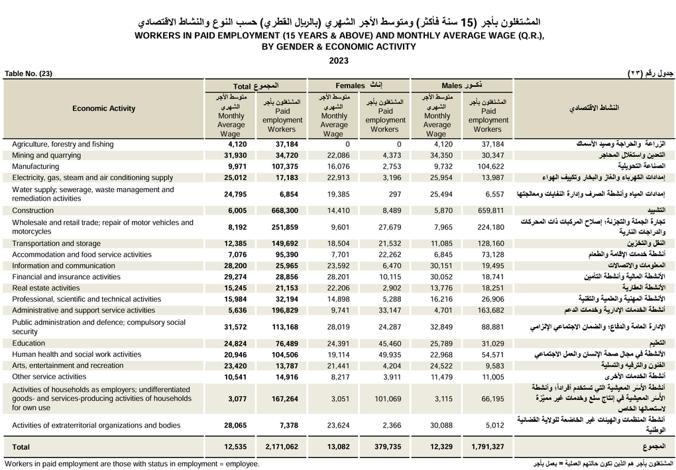
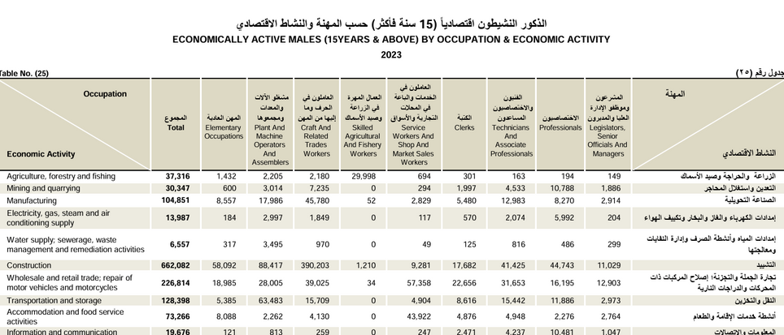
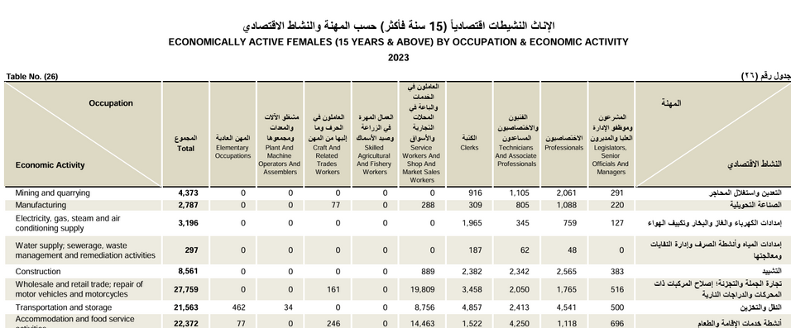
Labour Force Datasets from NPC’s Website
Economically Active Population (15 years and above) by Nationality, gender, & Economic Activity (2011-2023)
Workers in Paid Employment (15 years and above) and Monthly Average Wage (2011-2023)
Economically Active Males/Females (15 years and above) by Occupation & Economic Activity
Employed Persons (15 years and above) and Average Work Hours by Gender & Economic Activity
7

Slide 8
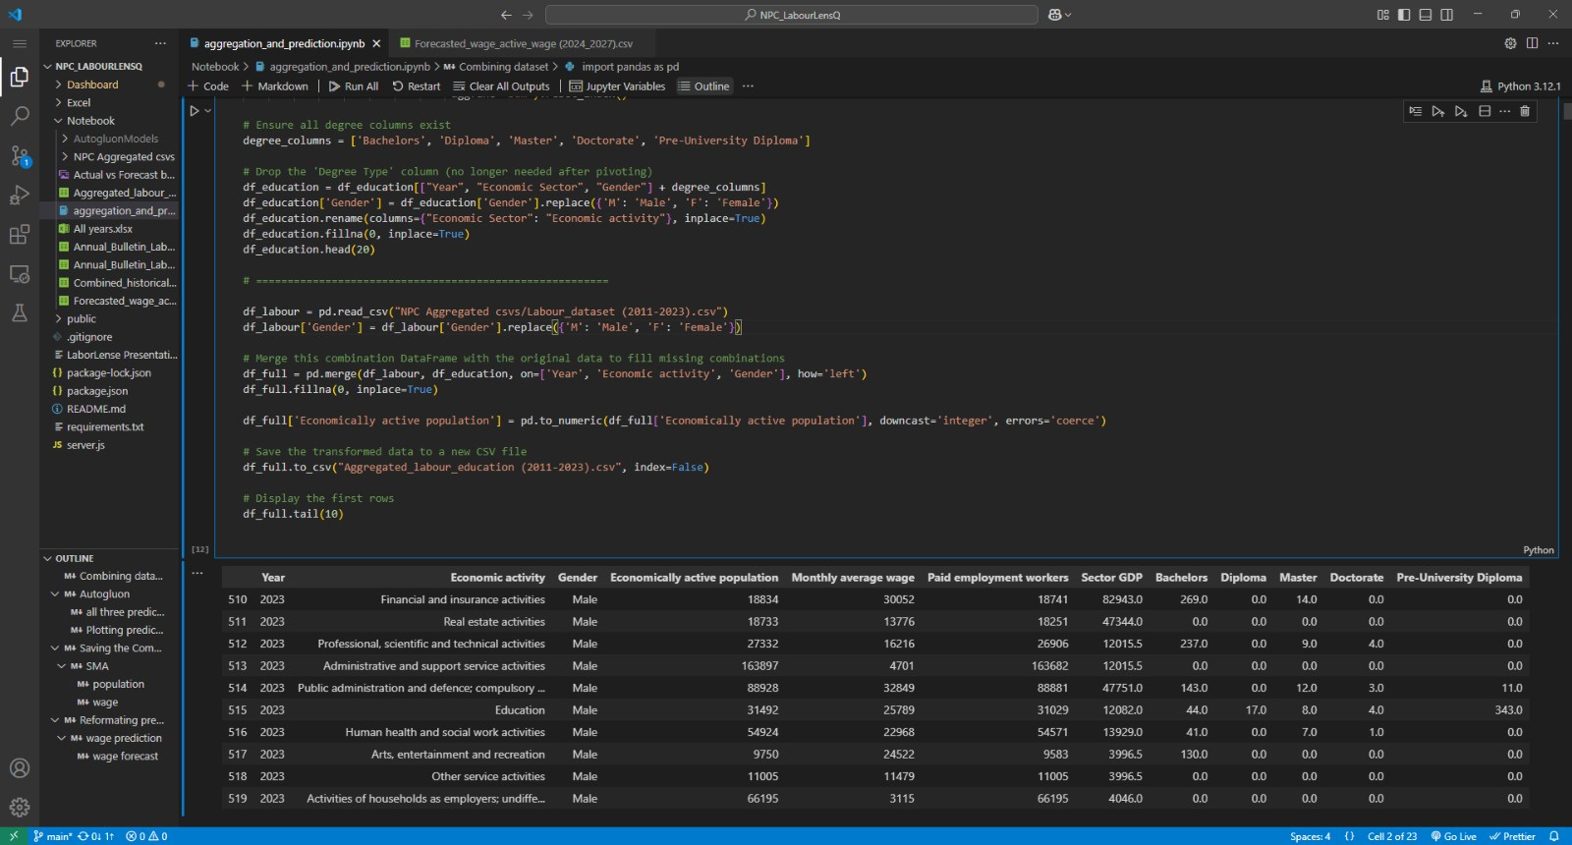
Code Demonstration
10

Slide 9



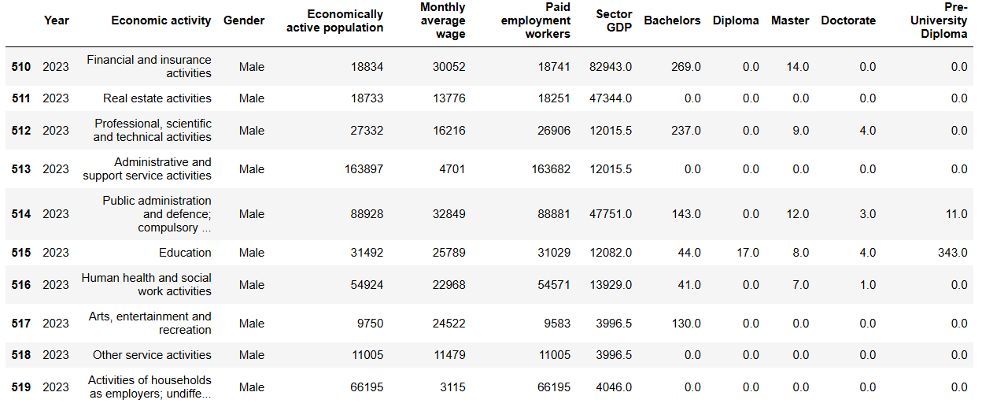
Aggregated Data
8

Slide 10
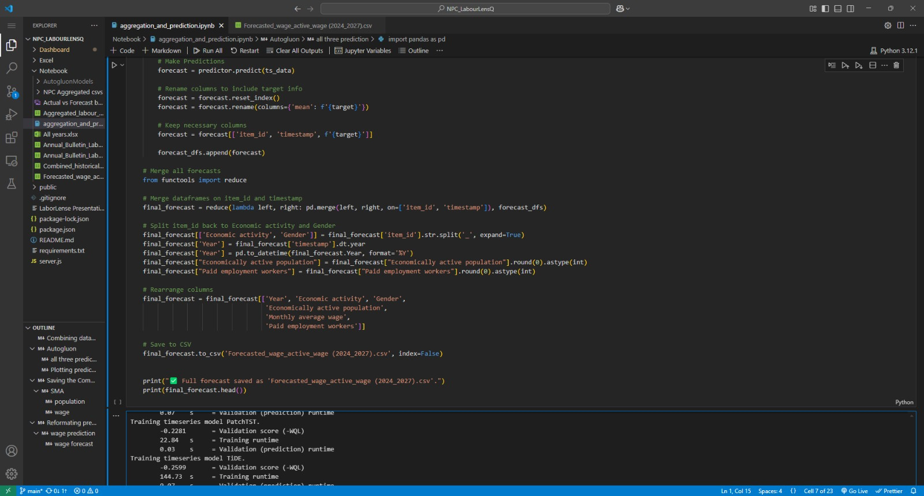
Code Demonstration
9

Slide 11


Advanced Predictive Modeling:
Weighted Ensemble Approach
Combines multiple models to enhance forecasting accuracy.
Optimized using TimeSeriesGreedyEnsemble to balance performance and efficiency.
Evaluated with Weighted Quantile Loss (WQL) for robustness.
Model Contributions
Performance Insights
PatchTST - 81.4% (Primary contributor, capturing complex patterns)
SeasonalNaive - 13.4% (Accounts for seasonal labor trends)
RecursiveTabular - 5.2% (Adds structured tabular insights)
Prediction length: 4 years
Optimized for yearly labor market forecasts (YS-JAN frequency)
12

Slide 12

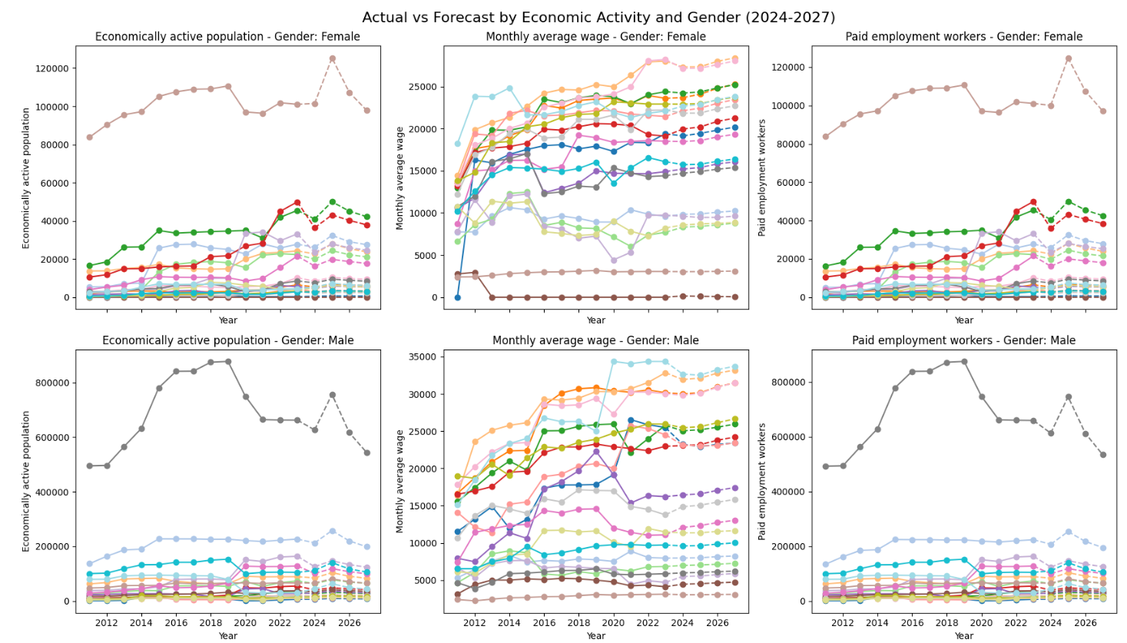
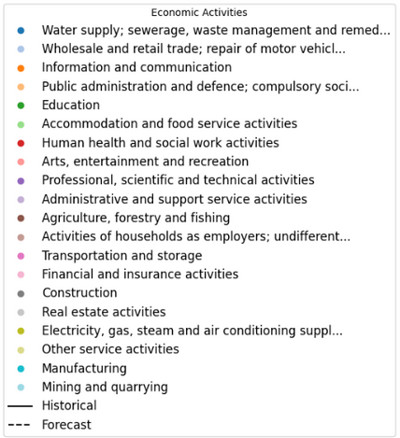
Summary Plots
13

Slide 13

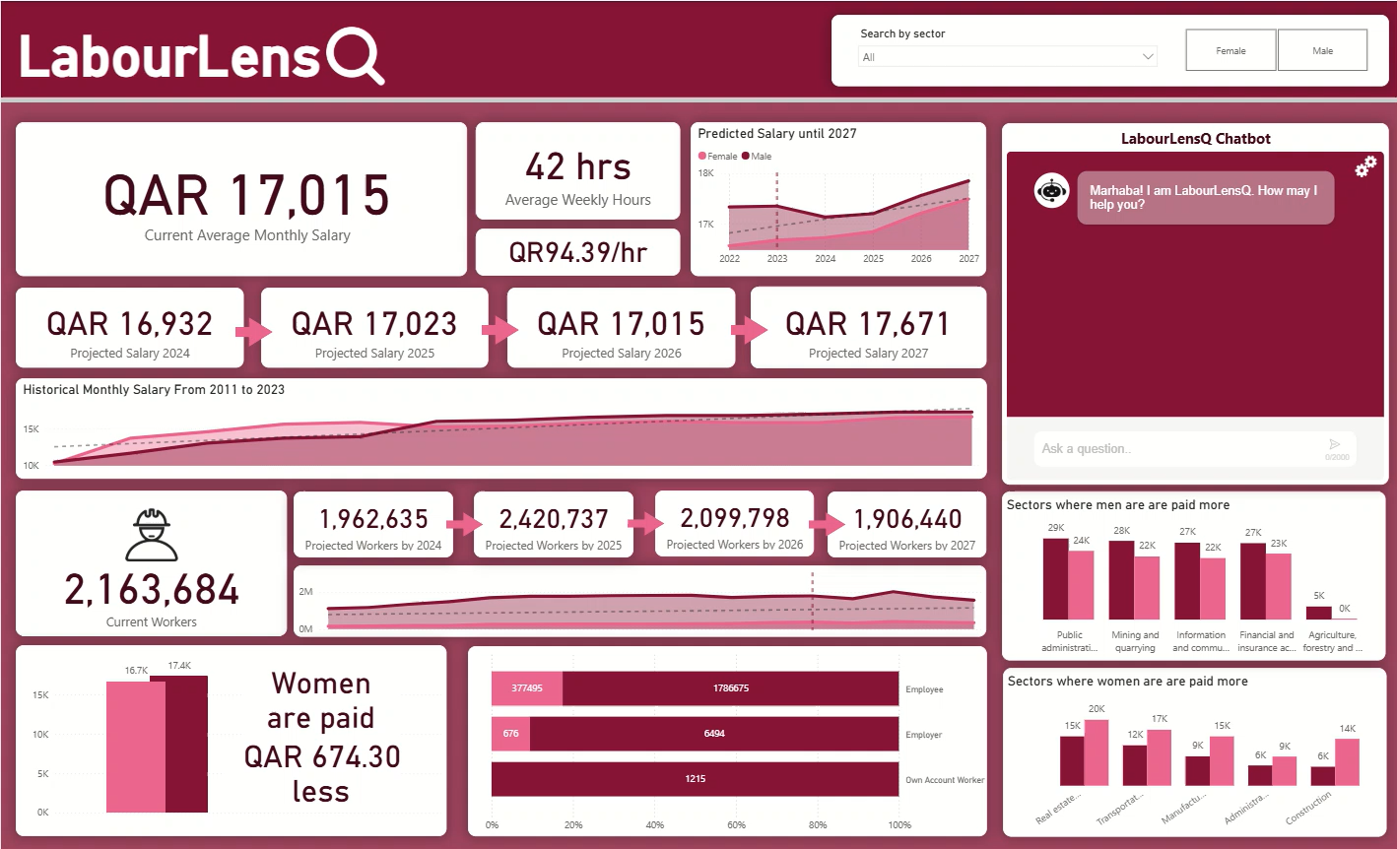
Dashboard in Power BI
14

Slide 14
AI-Powered Chatbot for Instant Labor Market Insights
An interactive chatbot integrated into our Power BI dashboard, designed to provide real-time answers to labor market queries.
How it works?
Key Features
Users type natural language questions
The chatbot retrieves insights from structured labor data.
✅Conversational AI
✅ Instant Data Retrieval
✅ User-Friendly
15

Slide 15
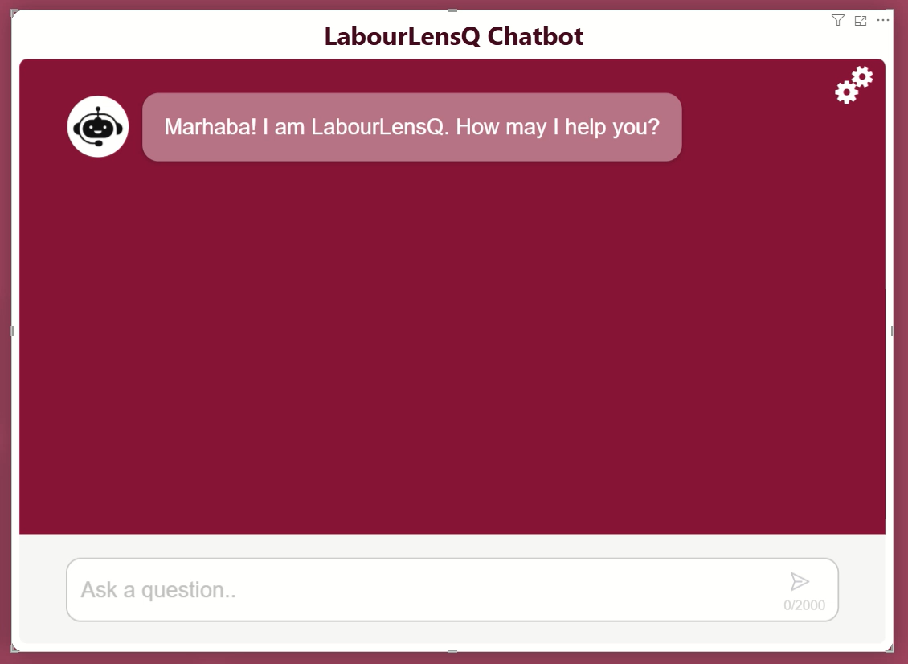
Power BI Chatbot Demo
14

Slide 16


Future Directions
Expanding Data Sources
Improved Predictive Models
Real-Time Market Insights
Integrate additional datasets to provide a more comprehensive and inclusive labor market analysis.
Refine models with iterative improvements to address data gaps and enhance reliability with advanced ML techniques
Enable live data updates for timely and dynamic labor trend monitoring and improve dashboard capabilities
16

Slide 17
Thank You and Any Questions?
17

